Slide 1
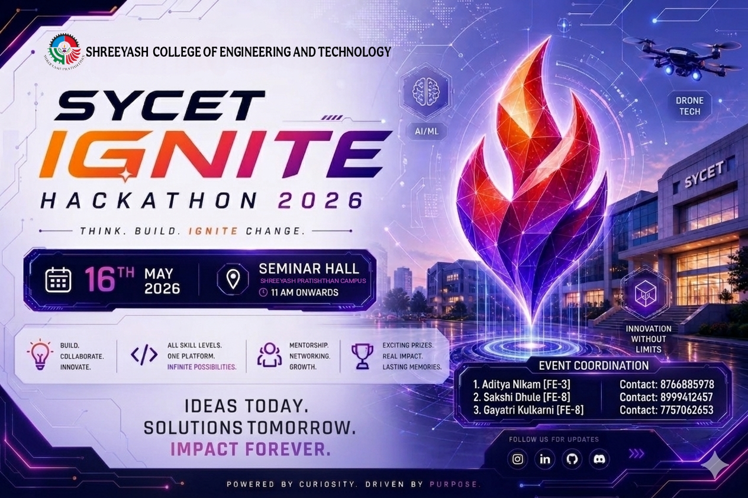
D AI-Based Online Exam Proctoring System
Category: AI/ML + Web Development

Slide 2
MEET THE TEAM
Rutik Gavhane
Frontend Developer
Aditya Anande
Backend & real time Communication
Durgesh Rithe
UI/UX Designer
Sanket Navpute
AI/ML Monitoring

Slide 3
01. PROBLEM STATEMENT
The problem..
IMPACT POTENTIAL
Traditional online examinations lack proper real-time monitoring systems, making cheating detection and exam integrity difficult during remote assessments.
Students can engage in suspicious activities such as looking away from the screen, talking, leaving the camera view, or switching tabs without immediate detection.
Target Users:
Colleges
Universities online learning platforms
Pain Points:
No live monitoring
Difficult suspicious activity detection Manual supervision efficiency
Market Need:
Growing online education platforms require AI-assisted automated proctoring system

Slide 4
02. OUR SOLUTION
How does our solution work? What makes it unique?
Feature 1 :
Description of key functionality : Real-time AI monitoring using OpenCV and MediaPipe to detect suspicious activities like face absence, head movement, mouth movement, and tab switching during online examinations.
Feature 2 :
How it benefits users : Ensures fair and secure online examinations through automated real-time monitoring, instant suspicious activity detection, reduced manual supervision, and live admin tracking for better exam integrity.
Feature 3 :
Unique selling point : 1) Admin Dashboard (Admin can terminate exam)
2) Live student monitoring, warning tracking, and activity logs.
3) Automatically terminate exam if student switches the tab.

Slide 5
03. TECHNOLOGY STACK
Frontend
Backend
Tools & APIs
Database
HTML
CSS
JavaScript
Socket IO
Python
Flask
Flask-Socket IO
Open CV
Media Pipe
NumPy
Webcam API’s
Font Awesome
Current : In-memory Python storage
Future : SQLite + SQLAIchemy

Slide 6
04. ARCHITECTURE & WORKFLOW
Student Webcam
Browser JavaScript
Socket.IO Frame Transfer
MediaPipe Face Detection
Behaviour Analysis
Flask Backhend
OpenCV Processing
Warning Generation
Student UI + Admin Dashboard

Slide 7
05. LIVE DEMO & FEATURES
Feature Demonstration 1:
Candidate Login & Exam Dashboard.
admin login also available
Feature Demonstration 2 :
Real-Time Webcam Monitoring & Warning Detection.
movement detections like head moment , face absence, or mouth movements
Feature Demonstration 3 :
Admin Dashboard with Live Activity Logs.
Browser tab switching warning
Fullscreen mode monitoring
Instant warning generation system

Slide 8
Feature Demonstration 4
Live admin dashboard monitoring
Real-time candidate activity logs
Warning tracking system
Admin-controlled candidate termination
Feature Demonstration 5
Automatic exam submission after termination
Real-time Socket.IO communication
Smooth AI detection workflow

Slide 9
06. CHALLENGES & SOLUTIONS
CHALLENGES
SOLUTIONS
Real Time Frame Process handling without causing system lag , or high CPU usage during online examinations.
Low-latency communication
False Warning Generation for very small or casual activities.
Managing Multiple Candidate Activities
Optimized OpenCV frame processing and reduced frame transfer load.
Used Socket.IO for fast real time communication
Added detection thresholds and delay logic .
Developed a live admin dashboard with real time activity logs and monitoring features

Slide 10
07. RESULTS & METRICS
Low-latency frame processing using Socket.IO
live admin dashboard for monitoring candidates
~90%
500ms
5+
Face Detection Accuracy
Frame Processing Interval
Warning Types
Data showing project impact, performance gains, and user engagement

Slide 11
08. FUTURE ROADMAP
1
Phase 1
Candidate Login System
Suspicious activity detection
Warning generation system
Browser tab switching integration
Live Admin dashboard
Current MVP
2
Phase 2
SQLite database integration
Voice and audio detection
Multi-room examination
Face recognisation authentication
Advanced Features
Phase 3
Mobile phone detection
Cloud deployment
Deep-learning behaviour analysis
Institution-wide monitoring system
3
Future Expansion

Slide 12
Thank You
“Building Smarter and More Secure Online Examinations Through AI”
CONNECT WITH US
Team Email: teamproctorx03@gmail.com
GitHub: https://github.com/Aditya03N/ai-proctoring-system.git
With ❤️ from Team Proctor X

